Slide 1


Networks graph theory
blah
Getting connected

Slide 2
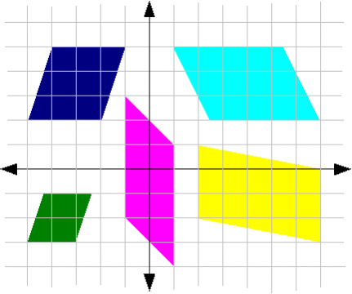
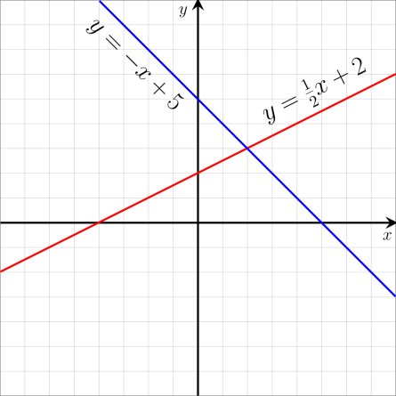
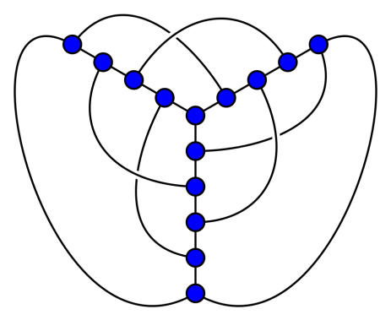
Graph theory - misleading title
We have met graphs before when we studied functions and matrices
We now use the term with a wider meaning for any network of lines that are put together with some joining elements

Slide 3
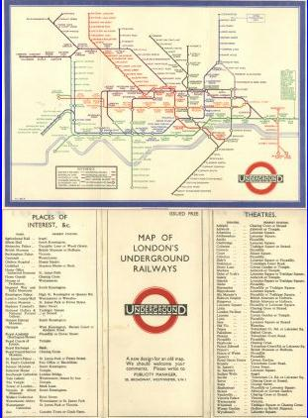
Harry Beck
Designed this map in 1933
Got paid 10 guineas (£10.50)
That was the equivalent of 2 weeks wages
ref https://en.wikipedia.org/wiki/Harry_Beck

Slide 4
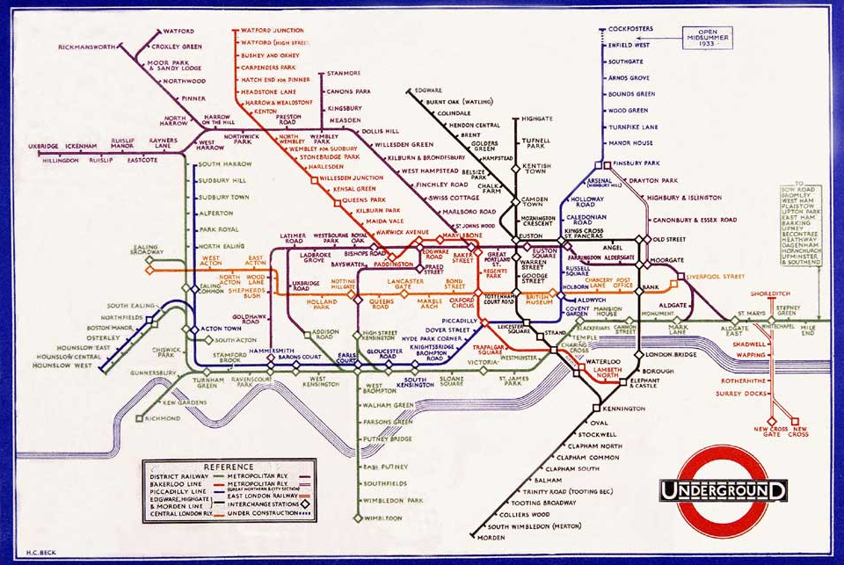

Slide 5
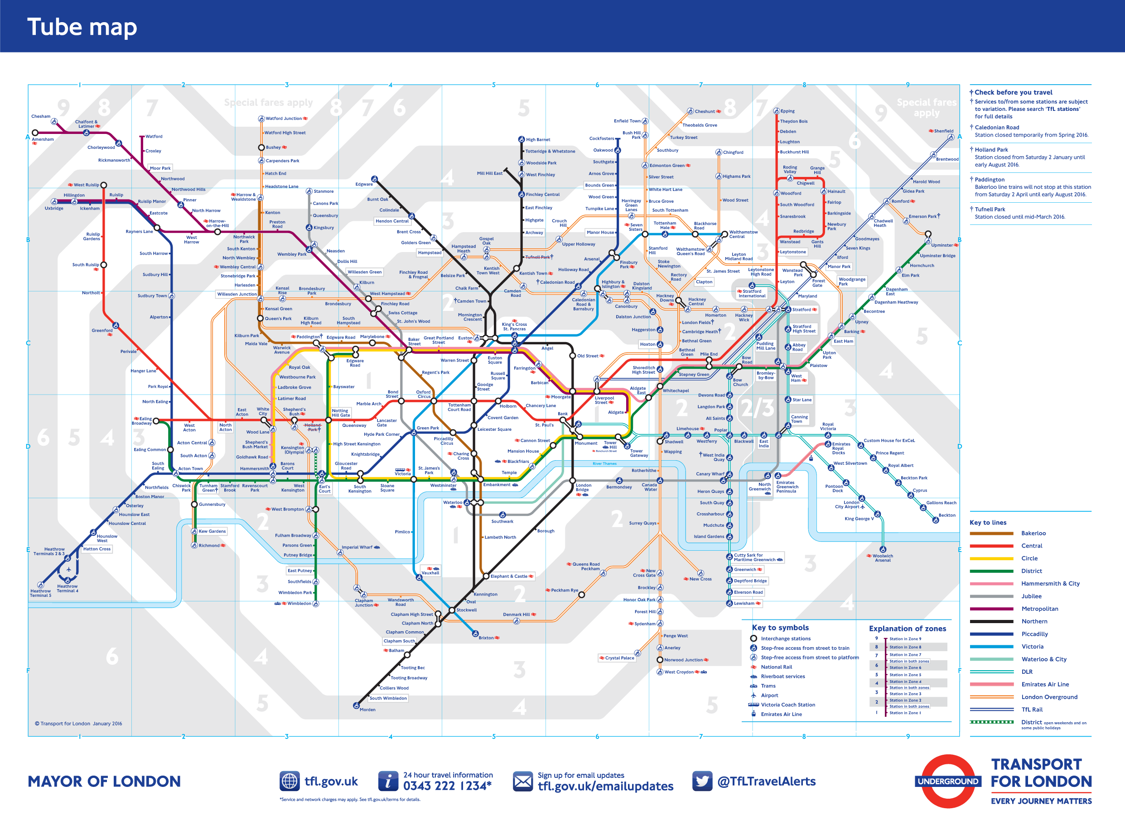

Slide 6
Underground ‘Map’
Are the distances correct?
Are the directions correct?
Does the river look right?
Should all the lines be straight?
What information does it give?
What the different stations are
e.g. Brent Cross
What the different routes are
e.g. Bakerloo Line
Which stations are connected to each other on the same line
e.g. Brent Cross and Chalk Farm YES
Brent Cross and Neasdon NO
The route between stations which are connected to each other on the same line
e.g. Brent Cross, Golders Green,
Hampstead, Belsize Park, Chalk Farm
How the different lines are connected
e.g. Central meets Victoria at Oxford Circus

Slide 7
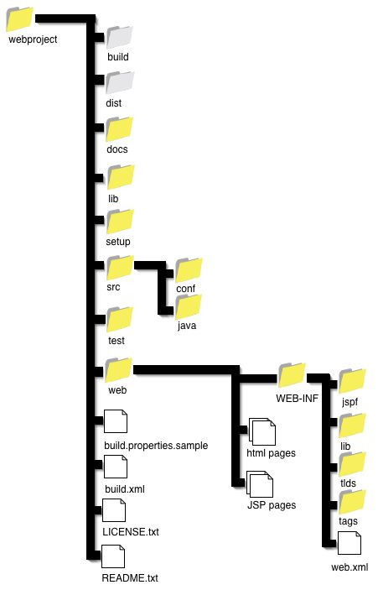
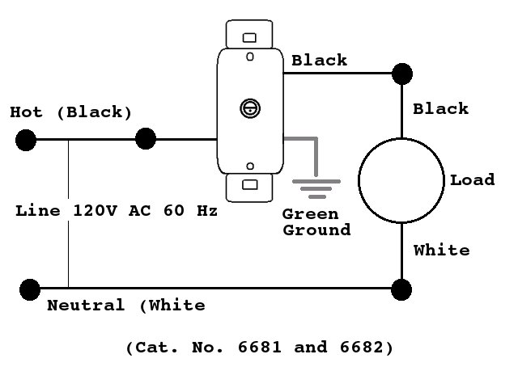
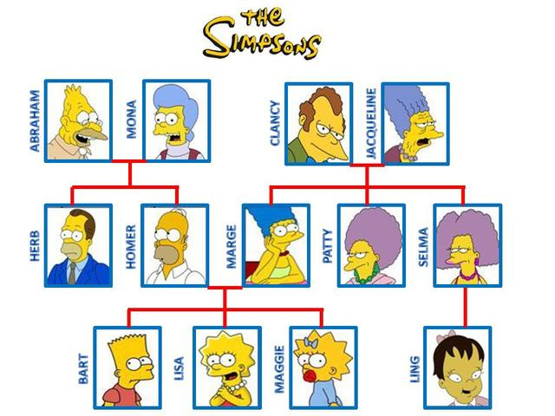
Diagrams
Wiring diagrams
File Structures
We use these to display ‘connections’ and ‘objects’ to be connected
Structure Charts
Family trees

Slide 8
‘Maps’
(Cable company example from book )
A leading TV company is setting up a new cable TV company based at Leicester which has existing connections as shown to the towns Derby, Nottingham, Grantham, Ashby-de-la-Zouch, Loughborough and Melton Mowbray. Find the minimum amount of cable which will connect all the towns.
(distances between towns shown in miles)
Here in this ‘map’ only the connections are of interest and the distances given
‘as the crow flies’ in the way the cables would be laid.
What could you use it for?

Slide 9
‘Maps’
Working out total miles of cabling required?
YES
How to get to the towns avoiding motorways?
NO
Check which cabling runs NS and which EW?
NO
Look to see which towns could be connected to Loughborough?
YES

Slide 10
Sat Nav and alternative version
Does it show direction?
Does it show junctions?
Does it give distances?
YOUR ROUTE TO GRADUATION
studying
TIMETABLE ALLEY
COURSES CRESCENT
REGISTRATION
ROUNDABOUT
free
time
work
FINANCE (Dead end)
friends
GRENAV

Slide 11


Königsberg – a city split into several parts, A,B,C and D, by the river Pregel
C
Walking over every bridge just once, try to get back to your starting part of the city
D
A
River Pregel
B

Slide 12
Euler (https://en.wikipedia.org/wiki/Leonhard_Euler)
This problem was first described by Leonhard Euler in 1736!!
He translated the problem into a ‘graph’ with the lines representing the bridges and the intersections as the land
He proved many properties
about graphs and gave his
name to the Euler Circuit
which describes this sort
of walk
A walk returning to its starting
point is also called a cycle
C
D
A
B

Slide 13
Comparison of diagrams
C
C
D
D
A
A
River Pregel
B
B

Slide 14
Terminology - A graph G is made up from two finite sets
Set of vertices
V = {v₁ , v₂ , v₃ , ..., v_{k}}
In previous examples the vertices have been
underground stations on the tube map
towns for a cabling company
junction boxes in a wiring diagram
parts of the city of Königsberg
Set of edges
E = {( v1, v5 ), ( v2, v3 ),… }
These show which vertices are connected
In previous examples the edges have been
underground lines on the tube map
distances for a cabling company
wires in a wiring diagram
bridges connecting the city of Königsberg
The single of vertices is
vertex

Slide 15
Terminology
Let G be V ={a,b,c,d,e} and E = {(a,b) (d,e) (b,d) (c,e)}
Draw the graph described by these two sets
HINT start by putting 5 blobs down and label them a,b,c,d,e
d
a
b
a
a
b
c
e
b
d
c
c
d
e
e

Slide 16
Spot the difference
The train line goes directly from Lewisham to Bexleyheath and from Lewisham to Bexley but NOT from Bexley to Bexleyheath
We can put this information into a graph in different shapes.
However this last one has the wrong connections and so gives the wrong information
BH
BH
L
B
L
B
B
BH
L
B
L
BH

Slide 17
Simple?
Simple – no loops, no multiple edges
Not simple (loop)
Not simple (multiple edge)

Slide 18
Walk - A walk in G is a sequence of edges
e.g. (A,B), (B,D), (D,C), (C,A)
e.g.(A,B), (B,C),(C,D),(D,B)
Graph, G
A
A
A
B
B
B
C
C
C
D
D
D
These walks ( both length 4) can be written in shorter form as
ABDCA and ABCDB
Note the length is the number of edges NOT vertices

Slide 19
Walks, Paths and Trails
All sequences of edges around a graph from vertex to vertex are walks but some of them have special properties.
If all the edges of a walk are distinct we have a trail. e.g. A,B,C,D,B
If all the vertices of a walk are distinct we have a path. e.g. B,A,C,D
A
A
B
B
C
C
D
D

Slide 20
Walks, Trails and Paths - Walk Wherever you Want to
Revisit places using the same routes

Slide 21
Walks, Trails and Paths -Trail to somewhere Twice, Two different ways
Revisit places using the different routes

Slide 22

Walks, Trails and Paths - Paths only Pick a Place once
John
O’ Groats
Edinburgh
Never revisit places
Bi rmingham
London
Land’s End
YDF 2014/15 Lecture 5 AMC

Slide 23
These are proper subgroups
Just as N ⊂ Z ⊂ Q ⊂ R and
squares ⊂ rectangles ⊂ quadrilaterals
paths ⊂ trails ⊂ walks
quadrilaterals
rectangles
squares
walks trails paths
e≠ e≠ v≠
All are walks
Some walks are trails
Some trails are paths

Slide 24
G
b
a
Given the graph G decide whether the following are paths, trails or just walks.
Give their length
c
e
Revisit places using the same routes WALK
Revisit places using the different routes TRAIL
d
Never revisit places PATH
abdba
cae
bdbdbac
caec
eabd
Walk length 4
ab
eae
* * * * * * *
cadb
eace
Path length 1
Path length 2
Walk length 2
Walk length 6
Walk length 6
Trail length 3
Not a walk
Path length 3
Trail length 3

Slide 25
Are you connected?
For a star or hub network
the computers radiate out from a central server
For this to represent a computer network all the computers have to be connected

Slide 26
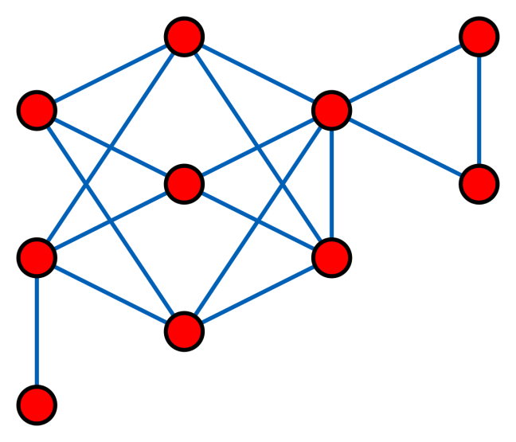
Are you connected?
Not Connected
Connected
A graph G is connected if given any 2 vertices there exists a walk between them
sometimes written (∀ v_{i} ,, v_{j} ∈ G , ∃ walk v_{i} ,……., v_{j} )
i.e you could draw between any 2 vertices without taking your pencil off the paper

Slide 27
Trees
A connected graph with no cycles is called a tree
Not a tree
Has a cycle
Not a tree
Not connected
A tree

Slide 28
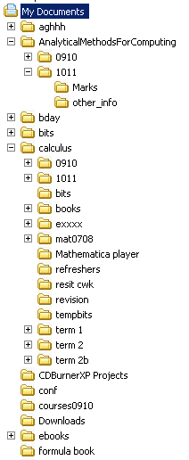
Tree example
The standard file and directory structure is a tree
AMfC/
1516
w
Tutorial1
w
Tutorial2
no direct loops between files
w
Tutorial3

Slide 29
Subgraphs
b
G
b
a
a
e
c
c
d
d
subgraphs of G
A subgraph of a graph G is a graph
all of whose vertices are in G and
all of whose edges are in G.

Slide 30
Spanning trees
A spanning tree of a graph
is a special subgraph which includes
all the vertices of G and is
also a tree.
Spanning trees
If G has n vertices, a spanning tree will have n - 1 edges

Slide 31
Adjacency Matrices
Adjacency matrices can easily be used to describe the connections of a graph and input them into a computer
If A is the adjacency matrix of G then the entry a_{ij} = 1 if there is an edge between v_{i} and v_{j}. Otherwise the entry is 0.
v₁ v₂ v₃ v₄
v₁
v₂
v₃
v₄
A=

Slide 32
Another example
a b c d e
a
b
c
d
e
This is 1 because e is connected to c

Slide 33
a b c d e
⎛
0
1
1
1
0
⎞
⎜
⎟
⎜
1
0
1
0
1
⎟
⎜
⎟
a
b
c
d
e
1
1
0
1
1
⎜
⎟
⎜
1
0
1
0
1
⎟
⎜
⎟
⎝
0
1
1
1
0
⎠
NOTE
0’s on leading diagonal- no loops
symmetry because if a is connected to b, then b is connected to a
with undirected graphs (no one way streets)

Slide 34
Find the adjacency matrices
C
B
R
P
D
T
S
A
Q

Slide 35
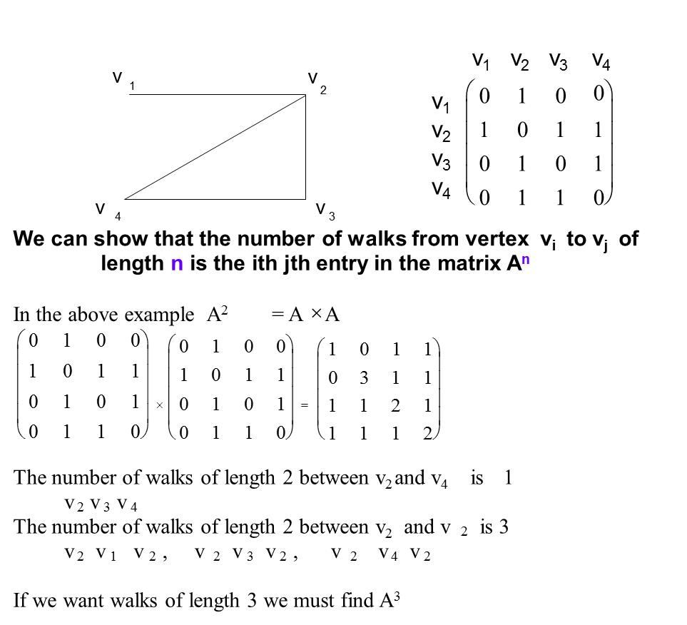

Slide 36
C
B
3 walks of length2 from B to B
D
BDB , BAB, BCB
A
5 walks of length 3 from A to B
ABDB , ABAB, ABCB, ADCB,ADAB
A =
5 walks of length 3 from C to D
CBAD,CBCD,CDBD,CDAD,CDCD

Slide 37
Another example
a
b
How many walks of length 4 are there from a to c?
So we have 9 ‘four stage routes’ from a to c
abdbc ababc abcdc acbdc acdbc abcac
abcbc acabc acbac
d
c
A
A²
=
A⁴
=

Slide 38
Today
Work on graph theory in tutorial
Try and do Q 1-6 on the Graph theory

